Slide 1

G-SRS Annual Update
USP Digital Platform and Health IT Activities
November 16th, 2018
Steve Emrick

Slide 2

Agenda
USP Digital Presence & Public Health Role
Current State and Solutions: Standard translation
USP Compendial Nomenclature
Drug Classifications
Hazardous Drugs
Drug Allergies and Intolerances
Future Trajectory
G-SRS and upstream alignment
Stay Engaged
Workshops & Roundtables
2020-2025 Convention
Notes:
Welcome
Objective: to orient you USP, who we are and our role in public health, but importantly share with you our renewed commitment to helping beyond the standard. We recognize that the standard setting process is essential to driving towards quality and safety for patients and healthcare workers but we also recognize the supplemental tools are needed to help support the end users in engaging with the standards.
To this end we are here today to also share with you our work and envisioned trajectory in the IT, digital realm.
One of our goals today is not only to inform you on our current state (and desired future state) with digital platform and Health IT activities, but to listen to what you think and give us feedback on where USP could provide value given our standards-setting role.
In some ways, USP, as an organization that has traditionally been focused on print publications/compendia, has not fully leveraged our data and made it accessible. So we are in the midst of a change where we want to be a trusted partner that allows integration of our standards content into the Health IT ecosystem.

Slide 3
Background: USP & Digital Presence

Slide 4
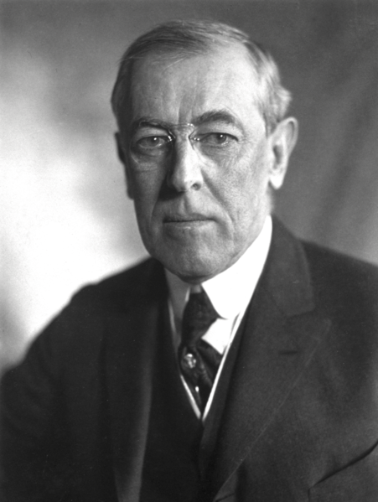
A person’s metadata (circa 1900)
First Name
Last Name
Date of birth
Place of birth
Address
Sex
Height
Weight
Eye color
Hair color
Race
Mother’s Maiden Name
Father’s Name
Occupation
Marital Status
28th US President!!
Social Security Number

Slide 5

A person’s metadata today
Picture of your lunch that you posted on Instagram
Your connections on LinkedIn
What you searched on the internet in the last 24 hrs
Your friends on Facebook
Most frequently listened to songs on Spotify
What you’ve bought on Amazon in the last year
All the places you went yesterday
How quickly you metabolize warfarin
Notes:
The digital you is more important than the real you!

Slide 6
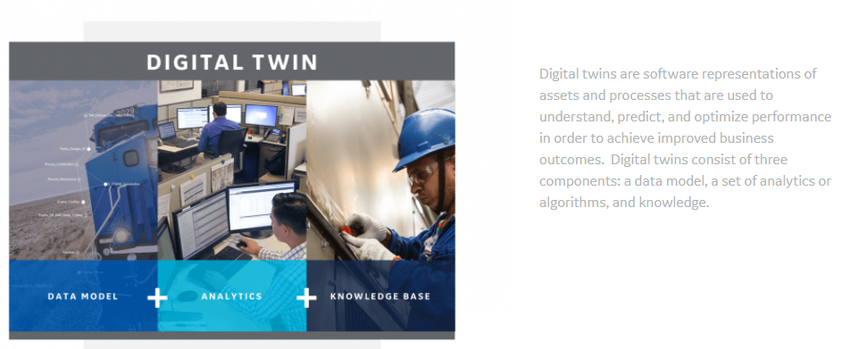
The GE Digital Twin

Slide 7
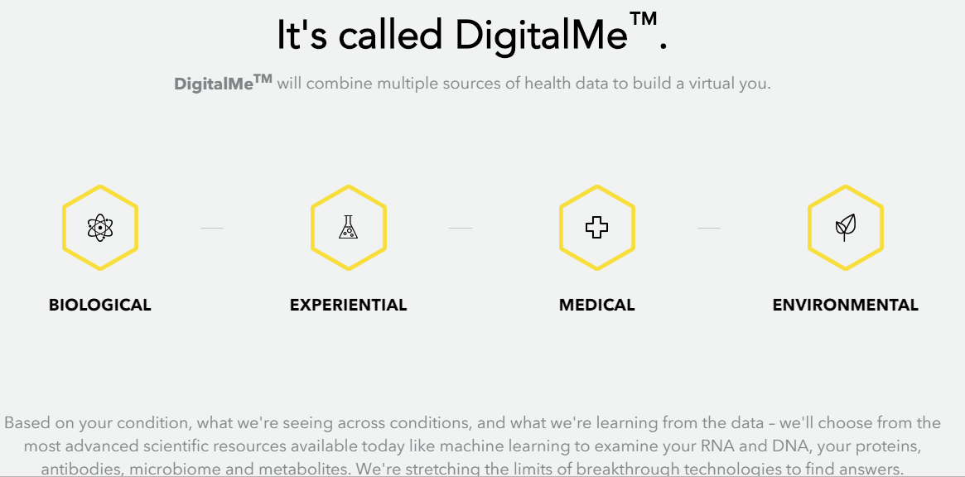
PatientsLikeMe

Slide 8
The importance of digital presence
Digitally computable metadata is hugely valuable in every industry
Sports, finance, weather– why?
For many organizations, digital absence can be disastrous
For USP, digital absence can hinder our standards ability to deliver positive public health impact
What are USP’s ‘digital twins’?

Slide 9
USP & Public Health Role

Slide 10


About Healthcare Quality & Safety
The quality of medicine and how it’s delivered to patients is fundamental to treating illness and maintaining health.
We help build the safety net across the drug industry and healthcare system, establishing standards to help ensure medicine is of the highest quality from the time it’s manufactured until the moment someone takes it.
Notes:
Specifically, we represent Healthcare Quality & Safety or HQS.
We help build the safety net across the drug industry and healthcare system, establishing standards to help ensure medicine is of the highest quality from the time it’s manufactured until the moment someone takes it.
We do span the full supply chain to help ensure the delivery and access to quality medicine. … Within this spectrum we focus on the following… next slide
What we do today
Establish and disseminate public written standards for the quality, purity, identity, strength, and labeling of medicines
Provide recommendations to practitioners on the safe use of medicines
Work with national and international health agencies to improve the quality of medicines worldwide
Educate practitioners and others seeking information and implementation of quality standards

Slide 11







Healthcare Quality & Safety
USP Healthcare Quality and Safety (HQS) supports the development and implementation of science-based standards and services to ensure accessibility and the informed, safe use of quality medicines for patients and healthcare providers.
↑ Safe Use of Medication & ↓Medication Errors
↓ Hazardous Drug Exposure to healthcare providers and patients
↑ Patient Health Literacy related to prescription drugs
Unsafe sterile and nonsterile Compounding Practices
Opioid-related standards
Errors caused by Drug Nomenclature
Impact
Across distribution channel and across the continuum of care
Manufacturers
>200 Manufacturers
>40 new drugs approved/year
Institutions
5,627 Hospitals
15,600 SNF
67,000 Pharmacies
Healthcare Providers
300K Pharmacists
380K Pharmacy techs
2.7M Nurses
1M MDs
Patients
33M hospital admissions
1.7M patients in SNF
4B prescriptions

Slide 12
HQS Portfolio
HQS
Protecting patients and healthcare workers.
Helping to ensure that medicine is safe from when it is made until it is taken.
Manufactures/ Industry
Policy Makers/ Regulators
Health Care Practitioner/ Associations
Consumers/ Patients
Safe Handling of Hazardous Drugs
Formulary / Drug Classification
Opioid
Epidemic
Labeling & Nomenclature
Quality Compounding
Medication Error Prevention
Documentary Solutions
Education
Digital Solutions (HI&T)
USP Science-driven Standards and Compendial Tools
Notes:
Who we are and what we do

Slide 13
USP standards impact many points along the drug data chain
Manufacturer
Institutions/Providers
Patients
Access
Substance verification
Impurities, Excipients
Nomenclature
Compounding,
Safe handling of HDs
Medication error prevention (NCC MERP)
Formulary Design
Translational Informatics
Encoded compounded drug formulations
HazRx™ DC
Drug Allergies and Intolerances
PGx*
USP Drug Classification
Medicare Model Guidelines
USP Compendial Nomenclature
G-SRS?

Slide 14
Creation of “USP Core Digital Content”
Nomenclature
Practice Standards
(Compounding, Labeling, Prescription Containers, MMG, Parenteral Nutrition Safety, Allergy and Intolerance)
USP-NF Monographs
(quality standards)
Notes:
Stepping back for a moment, USP has an organic set of core digital content, all tying back to our nomenclature that must be accessible externally to our stakeholders. These include our nomenclature, which is legally binding for drug manufacturers, quality standard monographs in the USP-NF, and HQS Standards in the areas of compounding, allergies and intolerances, formulary development, etc.

Slide 15
Integration of USP Standards into Health IT environments maximizes public health impact
Digital Translation
Platform
Hazardous Drugs
Drug Classification
Allergies &
Intollerences
HazRx™
Mobile App
HazRx™
Drug Classification
MMG
Alignment File
USP DC
Alignment File
Parenteral
Nutrition
TBD
TBD
Compounding
Monographs
Nomenclature
The Software
The Standards
The Products
Notes:
For many years, USP standards have only been available through the USP-NF, PDF files, or other printed materials. As the exchange of health information now happens digitally, this made it difficult for an increasingly digital world to interact with and implement our standards. We recognize that providing our stakeholders digital access to our standards is critical improving public health through implementation of our standards. Thus we are committed to providing translational products that facilitate implementation in Health IT environments.

Slide 16
Optimal state of core digital content
“USP Inside”
Mobile Apps
Quality Standards
Drug Information Systems
Academic Research Centers
Nomenclature
Lab Information Management Systems
Practice Standards
Digital Standards Ecosystem
Predictive Analytics Platforms
Notes:
By connecting our core content together, we can provide a value-added technology stack that ties back to our standards. External IT systems can answer questions such as is klonopin a hazardous drug, and how do I protect myself if I’m crushing a tablet for administration, what is the likelihood that a patient with a documented allergy of severe muscle pain due to atorvastatin will have a similar manifestation if given fluvastatin, etc.

Slide 17
Pathway to provide integration of USP Standards into Health IT systems
USP standards highly
integrated into Health IT Systems
(“USP Inside”)
Accessible USP ‘Core Content’
Broadened engagement with Health IT stakeholders
Phase III
Translational products
tied back to our standards
Phase II
Phase I
(underway)
Notes:
Talk about phases here, as well as roundtables that led to ONC/Pharma Health IT collaborative work and call for USP to provide drug allergy standard

Slide 18
Current State and Solutions Tailoring and Translation of USP Standards

Slide 19
USP Compendial Nomenclature Integration with RxNorm

Slide 20
What is RxNorm?
Drug terminology produced by NLM
RxNorm (drugs)
SNOMED CT (problem lists)
LOINC (lab tests)
List of normalized names and unique identifiers for drugs
Terminology derived from other drug terminologies

Slide 21
What is RxNorm?
FDA Structured Product Labels (DailyMed)
MeSH
NDF-RT
SNOMED CT
VA National Drug File
CMS Formulary Reference File
First DataBank
Gold Standard
Medi-Span
Multum
Micromedex
Anatomical Therapeutic Chemical Classification System (ingredients only)
USP Compendial Nomenclature!!
Notes:
Why RxNorm when other terminologies already exist?
-Many different naming conventions
-Many different codes

Slide 22
RxNorm use cases
RxNorm is designed for unambiguous, semantically interoperable drug exchange for:
Provider (CPOE) to pharmacy (e-prescribing) transactions
Drugs in patient medication lists (C-EHR Technology, 45 CFR § 170.207)
Drugs listed on formularies

Slide 23
Why RxNorm?
RANITIDINE HYDROCHLORIDE 15 MG ORAL SYRUP
RANITIDINE HYDROCHLORIDE 16.8 MG ORAL SYRUP
RANITIDINE HYDROCHLORIDE 75 MG/5mL ORAL SOLUTION
RxCUI: 705160
Normalized Name: Ranitidine15 MG/ML Oral Solution
The RxNorm model was built to provide a standard name for drugs as they appear in a provider's medication order, comprised of active ingredient, strength, and dose form.

Slide 24
Why USP Compendial Nomenclature in RxNorm? Digital Presence
Allows identification of the USP Compendial drug name in drug databases
Provides source of USP nomenclature within widely used vocabulary standard
Connects nomenclature required for use by drug manufacturers to nomenclature
used for prescribing/administration
Can improve data quality of public and private databases
Builds upon our strength by expanding our core mission of drug nomenclature
into digital environments
Programmatically reference our own nomenclature in publications (e.g. USP DC)

Slide 25
Challenges of integration with RxNorm
Data are not uniformly connected (due to salt form names)
Different granularities for dosage forms
Manufacturer vs dispensing/administration
USP will continue to work with NLM over time to uniformly connect concepts will lower implementation barriers for developers of drug information systems
USP/RxNorm merge
USP/RxNorm split
RxCUI 370579 (m4170)
USP Name | Amoxicillin Tablets
RxNorm Name | Amoxicillin Oral Tablet
RxCUI 83366 (m6340) |  | RxCUI 370621
USP Name | Relationship | RxNorm Name
Atorvastatin Calcium Tablets |  | Atorvastatin Oral Tablet

Slide 26
USP Compendial Nomenclature and RxNorm – better together!
Consistent mappings to our monographs
Single source of truth
Identify areas for improved content
USP
USP Internal Systems
USP Digital Products
NLM
RxNorm
USP Nomenclature
External implementations
+Compendial Accuracy
Easier implementation of USP standards
Opportunity to improve drug database content
*Credit: Graphic courtesy C. Edward Porter: Capstone Project for University of Maryland Master Program
Notes:
“RxNorm is two things: a normalized naming system for generic and branded drugs; and a tool for supporting semantic interoperation between drug terminologies and pharmacy knowledge base systems. The National Library of Medicine (NLM) produces RxNorm.”

Slide 27
Formulary Resources USP Drug Classification

Slide 28
USP Drug Classification
The USP Drug Classification (USP DC) is an independent drug classification system developed by the USP Healthcare Quality & Safety Expert Committee.
USP DC Use cases
Building, Mapping, and Comparing Formularies
Reviewing Formularies for a Minimum Baseline of Drugs
Identifying Drugs Included in a Particular Pharmacological Groupings
Insurers/PBMs
Health Institutions
EHB Compliance
Regulatory Agencies
Federal
States
Employer Benefit Managers/ Consultants
Regulatory Agencies
Outlier Analysis
Imputing Diagnosis
Policy Reviewers

Slide 29
Timeline of USP DC development
Medicare Modernization Act (2003)
Section 1860D-4(b)(3)(c) defines role of USP
“(ii) MODEL GUIDELINES- The secretary shall request the United States Pharmacopeia to develop, in consultation with pharmaceutical benefit managers and other interested parties, a list of categories and classes that may be used by prescription drug plans under this paragraph and to revise such classification from time to time to reflect changes in therapeutic uses of covered part D drugs and the additions of new covered part D drugs.”
MMG v7.0 released
USP DC for public comment
MMA
signed into law
MMG yearly updates
MMG v6.0 released
2003
2004
2005-
2010
2011
2014
2016
2017
2018
First version of USP MMG published
MMG v5.0
USP DC
2018 Released
ACA/establishment of EHB plans
Notes:
Medicare Modernization Act (2003)
Section 1860D-4(b)(3)(c) defines role of USP
“(ii) MODEL GUIDELINES- The secretary shall request the United States Pharmacopeia to develop, in consultation with pharmaceutical benefit managers and other interested parties, a list of categories and classes that may be used by prescription drug plans under this paragraph and to revise such classification from time to time to reflect changes in therapeutic uses of covered part D drugs and the additions of new covered part D drugs.”
2004 - USP Called upon to create science-based classification system to define minimum formulary for Part D coverage
2005 – USP publishes first version of MMG

Slide 30
Extended Use of USP Medicare Model Guidelines (Part D)
1. Category Class Drug Count Review for EHB Benchmark Plans
Compares the count of unique chemically distinct drugs in each USP Category and Class for each drug list with the benchmark. Used to compare formulary benefits of different types of plans such as employer plans versus health insurance exchange plans.
2. Non Discrimination Formulary Outlier Review
Identifies and flags as outliers those plans that have unusually large numbers of drugs subject to prior authorization and/or step therapy requirements in 25 USP classes.
3. Drug Risk Hybrid Analysis
The USP classification provides chemical ingredient level identifications to identify and group drugs used for certain diagnoses.
Notes:
As I mentioned, the USP Medicare Model Guidelines were originally intended to be used as a science-based standard to determine a minimum formulary check for Part D. However, like many classification systems, people began using the Model Guidelines for other purposes. For example, EHB Benchmark plans used the Model Guidelines classification structure to compare formulary benefits across the different plans. Unlike in Part D, the EHB prescription drug plans are required to cover at least the greater of 1 of each USP Category and Class or the same number of drugs in each Category and Class as the EHB benchmark plan
When they did this, they realized that there were drugs no listed on the MMG because of its Part D scope, including Anti-obesity agents, Infertiliity agents, etc. Stakeholders asked us to create a broader classification system that included more classes of drugs

Slide 31
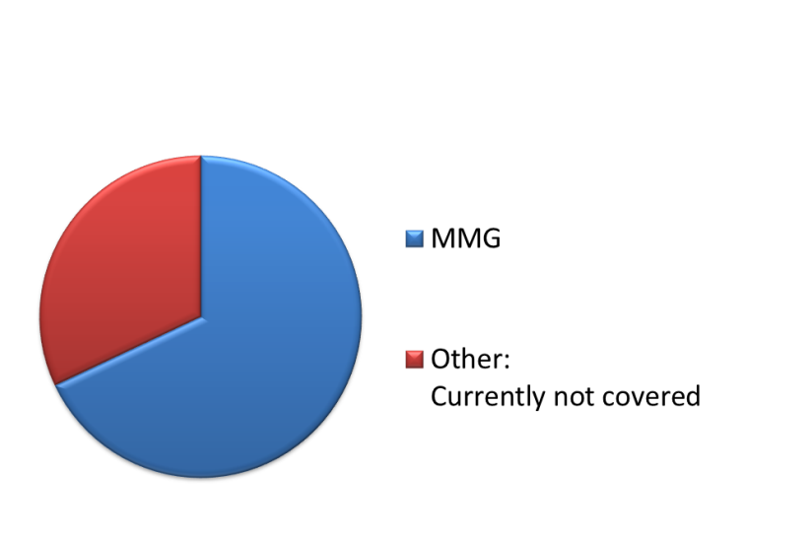
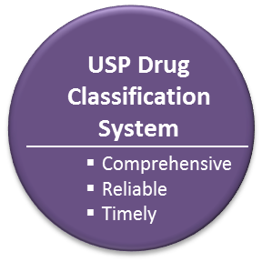
What lead to development of USP DC?
Opportunities for Improvement through > 10 years of Stakeholder Engagement
Need more frequent updates (at least once/year)
More comprehensive drug coverage (beyond Part D)
Increased granularity in certain USP Classes
Easier integration into Health IT platforms for formulary mapping
…and
USP MMG – Part D only
USP DC includes representation of:
Anti-obesity Agents
Sexual Disorder Agents
Contraceptives
Infertility Agents
Combination Drugs
Notes:
In addition to increased drug coverage, stakeholders also asked for more frequent updates (at least once/year), increased granularity in certain USP classes, and easier integration of our classification into Health IT systems

Slide 32
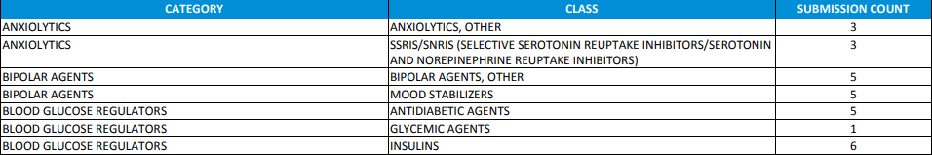
MMG/USP DC USE
Comparison of Rx Drug EHB Benchmark Plans – proxy to SDOH?
California
6 non-insulin Blood Glucose Regulators
Alaska
23 non-insulin Blood Glucose Regulators
Notes:
Showing how USP DC can be used a standard to compare formulary submissions, which could be used not only for cost analysis but to inform public health policy. For example here, we see that Alaska’s Rx EHB plan contains 23 drugs in the USP Category ‘Blood Glucose Regulators’, compared to a state with a much larger population – California. Important to note that USP does not choose the total number of drugs in each EHB plan – the states must cover the greater of a) at least 1 of each USP Category/Class or b) the equivalent # of drugs in each USP Category/Class in the state benchmark plan

Slide 33
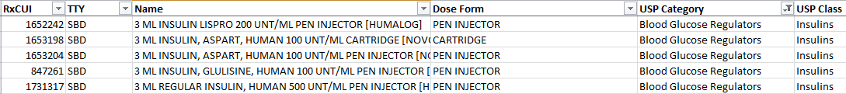
USP DC 2018 – Downloadable Files
USP DC 2018 Spreadsheet
Designed for ‘human readable’ formulary verification/comparison
USP DC 2018 Alignment File
Includes placement of RxCUIs (from Feb 2018 Current Prescribable Content) into USP Categories and Classes
Available as spreadsheet
Encoded identifiers of USP Categories/Classes immediate priority
CSV format available upon request, and will be part of standard outputs in the summer
Notes:
Download USP DC 2018 Files at: http://www.usp.org/health-quality-safety/usp-dc-download

Slide 34
USP DC – next steps
Addition of encoded identifiers for USP Categories and Classes (done!)
OTC Review based on stakeholder request
Comparison/Alignment with other standards (MED RT)
Review of dose form/route information
Consider adding NDC codes
Notes:
Showing how USP DC can be used a standard to compare formulary submissions, which could be used not only for cost analysis but to inform public health policy. For example here, we see that Alaska’s Rx EHB plan contains 33 drugs in the USP Category ‘Blood Glucose Regulators’, compared to a state with a much larger population – California. I was surprised at the results of this very trivial ‘data analysis’ to see such a big difference

Slide 35
Handling Hazardous Drugs Mobile App and Drug Classification

Slide 36
Public Health Challenge
Exposure to HDs can lead to acute and chronic illness ranging from rashes, to organ failure and cancer
NIOSH list has >200 HD drug listed that translate to more than 1,000 commercially available drugs
12 B doses of HDs are administered yearly in the US, yet less than 10% are labeled as hazardous drugs
8 million U.S. healthcare workers (HCW) are exposed to hazardous drugs (HDs) such as chemotherapeutics, hormone therapy, antiviral medication, during routine daily activities such as transport, compounding, administration across all healthcare settings

Slide 37
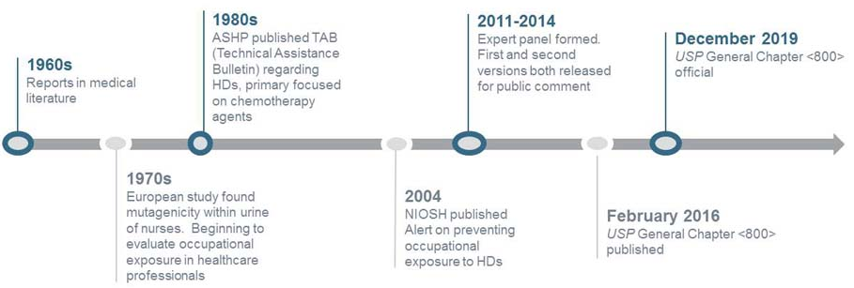
USP Compendial Response: USP GC <800>
USP General Chapter <800>, Hazardous Drugs—Handling in Healthcare Settings is created for the protection of Healthcare Workers, Patients and the Environment
Published in February 2016
Intended official date December 1, 2019 (prior July 2018)

Slide 38
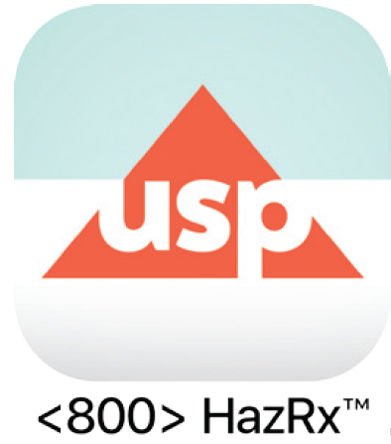
<800> HazRx™ Mobile App
An innovative app that computes information from three trusted data resources (NIOSH, RxNorm, GC <800>) to help identify HDs at the point of practice and to inform the healthcare worker on what measures to take to help reduce their risk in accordance to established standards.
Notes:
HazRx™ mobile app helps you identify if a drug is hazardous and provides guidance on the safe handling of that drug in accordance with USP General Chapter <800>

Slide 39
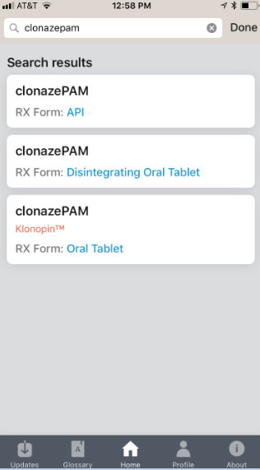
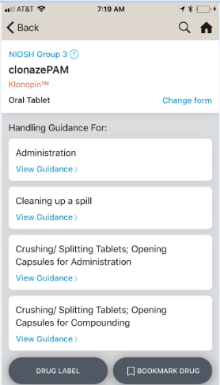
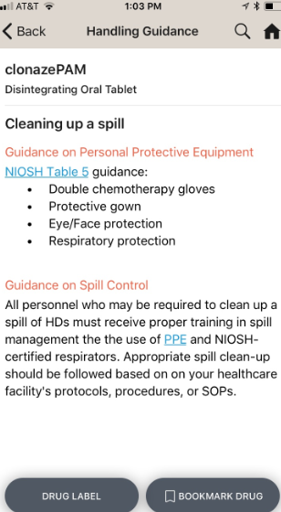
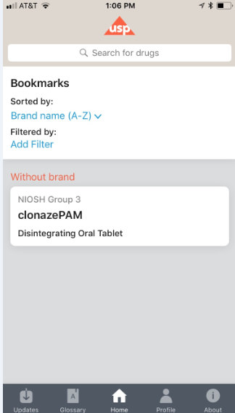
What it is and how it works
Computation
Output
Value
1. NIOSH/CDC List
1. Search
206 Drug Categories
Paper based
Formally updated every 2 years
Not recognized as preferred source
OneStop
Information Shop
Provides one-stop shop to search and retrieve generic and branded hazardous drugs, as well as handling information from USP General <800> as well as other sources such as NIOSH
2. Identify
Identifies and
Guides
Provides handling information based on a specific activity (compounding, etc.) and dosage form (injectable oral tablet, etc.)
2. RxNorm
1
3. Get Information
Intuitive &
Easy to Use
Easy to use
Intuitive
Simple solution
Fast access to data
> 1,000 commercially available drugs in US
Monthly updates
Not coded to recognize HDs
Source data not HCW friendly
2
3
4. Bookmark
Info at your
fingertips
Immediate, meaningful information available at the point of practice.
No internet connection necessary.
3. USP <800>
Provides guidance on how to safely handle HD
Static resource
Not recognized as known or preferred source
USP
<800> HazRx™
Mobile App
Stay Up-to-Date
Stay up-to-date on the list of over 1,000 hazardous drugs with monthly updates.
(Includes new FDA approved/discontinued drugs and NISOH updates)
Trusted
Brought to you by USP, standard setting organization and expert peers.
Leverages NIOSH, RxNorm and GC <800>

Slide 40
<800> HazRx™ Drug Classification Addresses Core Institutional Needs
Problem | HazRx™ DC Value
Hazardous drugs are ‘invisible’ in e-prescribing and drug information systems. | <800> HazRx™ Drug Classification provides the ability for E-prescribing systems to hook into NIOSH Group, hazardous drug handling activity, and appropriate handling guidance.
Institutions must maintain an updated list of hazardous drugs. | Institutions can match products from their inventory against the <800> HazRx™ Drug Classification, and update each month.
Healthcare providers may not be able to use mobile devices in their work environment. | <800> HazRx™ Drug Classification is designed to be integrated into E-prescribing systems and drug information systems where the providers are already working.

Slide 41
Allergies and Intolerances

Slide 42
Allergies/Intolerances Background and Timeline
Resolution submitted to USP to take over drug allergy work, begins Expert Panel meetings
Publish draft allergies intolerance data
2014
2015
2016 - 2017
2018-2019
ONC, HL7, others meet with USP to discuss current state of drug allergies
Expert Panel meetings
Technology platform development
Notes:
Medicare Modernization Act (2003)
Section 1860D-4(b)(3)(c) defines role of USP
“(ii) MODEL GUIDELINES- The secretary shall request the United States Pharmacopeia to develop, in consultation with pharmaceutical benefit managers and other interested parties, a list of categories and classes that may be used by prescription drug plans under this paragraph and to revise such classification from time to time to reflect changes in therapeutic uses of covered part D drugs and the additions of new covered part D drugs.”
2004 - USP Called upon to create science-based classification system to define minimum formulary for Part D coverage
2005 – USP publishes first version of MMG

Slide 43
Allergies/intolerances – public health problem and background
The Institute of Medicine, in its report To Err Is Human, estimated 7,000 deaths in the U.S. each year are due to preventable medication errors
Drug allergies or harmful drug interactions account for 11 percent of preventable medication errors
Because of the use of disparate systems and proprietary codesets to encode allergies, patient safety issues occur when drug allergy data is incorrectly transferred or omitted in transitions of care settings
Some of the early allergy value sets encoded information at the drug formulation level rather than ingredient + route (e..g atorvastatin oral tablet) which is how drug orders are entered and recorded in patient records
Providers have little insight into probability of cross-sensitivity within a drug class or even outside of a drug class

Slide 44
USP’s goals in developing drug allergy classes
Improve patient documentation through an encoded starter set of ‘the most frequent’ and ‘the most common’ drug allergy classes, ingredients, and manifestations
NSAIDs
Antibiotics
Cardiovascular Agents (ACEs/ARBs)
Opioids
Allow mapping from C-CDA and FHIR Allergy/Intolerance resource to the USP standard
Encode at ingredient level, rather than class
Mitigate problem of alert fatigue within EHR systems/CDS
Mitigate cross-sensitivity reactions via ‘predictability’

Slide 45

Science Process
Leverages USP process and Expert Committee
Relies on existing science and data
Data Sources
SPL/Daily Med
Literature
VA/DoD data
Other data sources
Designed for interoperability (RxNorm, SCT, USP Allergy Classes)
Literature
RxCUI
SNOMED CT
Expert
Committee
Review
Public
Forum
Value
Set

Slide 46
Allergies/Intolerances – standard around cross-sensitivity
Index Drug
Clinical Manifestation
?
Prospective Drug
Atorvastatin
Rhabdomyolysis
Simvastatin
What is the likelihood (predictability) that prescribing Simvastatin as an alternative to Atorvastatin will cause rhabdomyolysis?
Potential Future Activities
Proactively identify probability of cross reaction
Application beyond allergies to address clinical manifestation to leverage predictive analytics

Slide 47


Use Case 1- Provide encoded drug allergy classes to
improve interoperability
Patient Record
Substance: Atorvastatin
MFST: Rhabdomyolysis
Severity: High
Criticality: High
Improved mapping
Improved mapping
C-CDA
Allergies section
Allergy/Intolerance
Resource
Provide encoded
drug/manifestation pairs
USP Drug/Allergy Intolerance

Slide 48
Use Case 2- Provide predictability checking for FHIR/C-CDA
Patient Record
Substance: Atorvastatin
MFST: Rhabdomyolysis
Severity: High
Criticality: High
C-CDA
Allergies section
Allergy/Intolerance Resource
Could simvastatin cause rhabdomyolysis?
Could simvastatin cause rhabdomyolysis?
USP Drug/Allergy Intolerance
Predictability = High

Slide 49
G-SRS (Finally!)

Slide 50
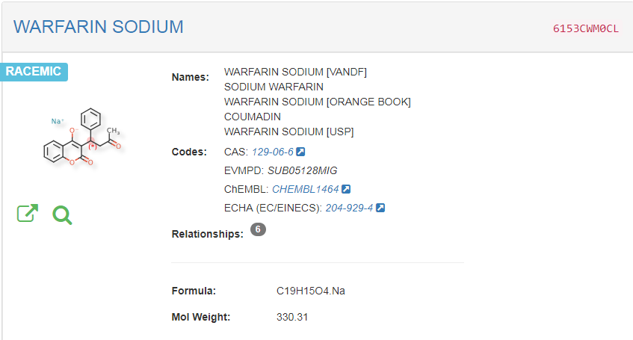
Enterprise Informatics Initiative: G-SRS Implementation
Fits into upstream USP “Digital Twin” Development
Nomenclature
Substance Verification
Impurity Profiles
Source of truth internally for:
Molecular Weights
Chemical Structures
USP Publications!
Links to other standards
RxNorm (external)
USP Drug Classification (internal)

Slide 51
Save the dates!!
Inaugural Pharmacoinformatics Workshop
April 3rd – 4th, 2019
Coming soon: 2020-2025 Convention
Have identified need for those with skills in areas such as Pharmacogenomics, vocab and messaging standards, digital therapies, informatics, implantable devices, etc
Notes:
Health IT Advisory Body – please let us know if you would like us to form this and participate!! There are so many areas where we could get involved, but we have to be mindful of our resources/capabilities. It is essential that we have consistent feedback and dialogue with people like those who attend HIMSS to thoughtfully inform where USP can provide the most value

Slide 52
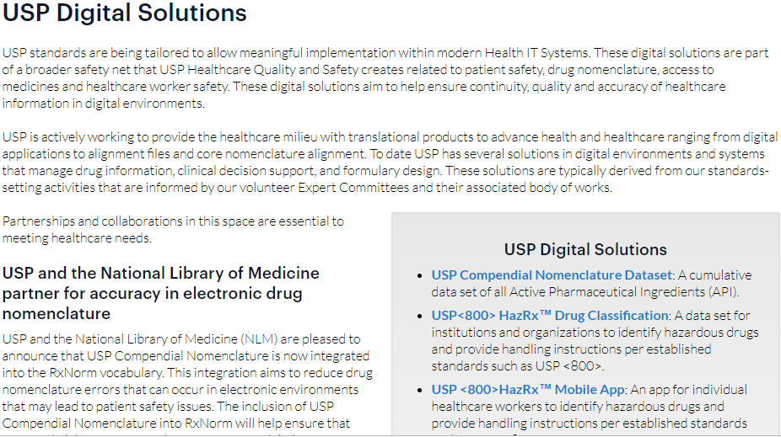
Check it out!
http://www.usp.org/healthcare-quality-safety/digital-solutions

Slide 53
Stay connected with us!!
Healthcare Quality & Safety Updates:
http://www.usp.org/hqs-signup-form
Twitter
@USPharmacopeia
E-mail
Steven Emrick (spe@usp.org)

